Slide 1
Alewijnse corporate presentation

Slide 2
Index
Our company
Our history
Our strategy
What we offer
How we work
Why we are unique
One Alewijnse
Our locations
Our customers
References
Why choosing Alewijnse?

Slide 3
Our company
All-round technological partner with over 130 years of experience in Maritime and Industry
Working in 4 segments:
Navy & governmental
Dredging & offshore
Yachting
Industry
New build, refit, solutions, panel-building, repair & maintenance projects
International footprint, own branches in the Netherlands, Romania, France and Vietnam
Competent & flexible, +/- 130 engineers, +/- 600 electrical installers
Our corporate video: https://www.youtube.com/watch?v=SNPG2fGugb4&t=30s

Slide 4
Our History – over a century of experience

Slide 5
Mission Statement
Mission
We Connect. Our passionate teams connect people and technology.
Vision
Our goal is to co-create value with and for our customers and partners. We aim to develop and improve electrification and automation solutions which are innovative, sustainable and of the highest quality.
We focus on making a valuable contribution to successful projects in the Maritime and Industrial sectors.

Slide 6
Our strategy
Strategy
We connect the dots in any complex system. Our aim is to be involved as a technology partner and create value for our customers. We are proud to work on the most innovative and challenging projects in the Yachting, Dredging, Offshore & Transport, Naval & Governmental and Industrial sectors.
Core values
Reliable
Involved
Transparent
Sustainable

Slide 7
What we offer
Our solutions
Vessel automation
Process automation
Navigation & Communication Systems
Electric Installation
Switchboards & Consoles
Power Distribution
Drive Systems
Hybrid Systems
Audio/Video & IT
Safety & Security

Slide 8
What we offer
Our international proposition
Design & consultancy
Systems integration
Project management
Engineering
Commissioning
Newbuild
Refits & Conversions
Solutions
Service & Maintenance
Panelbuilding
Spare parts delivery
Training

Slide 9
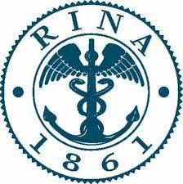
How we work
During the entire lifecycle & through the whole value chain
Safe
Dedicated
Sustainable
Quality focused

Slide 10
Why we are unique
Our specific Industrial & Maritime system knowledge
Delivering high quality with attention to detail
Our engineering capacity
Our installing capacity
Project management capabilities
Global availability
One stop shop
Inhouse panelbuilding production (Vietnam, Romania, Netherlands)
Refits & Conversions knowledge
24/7 Service & Maintenance

Slide 11
Alewijnse group
Navy & Government
Superyachts
Dredging, Offshore,
Transport
Industry
International Resource Pool
New Build
Refits
Solutions
Panelbuilding
Service

Slide 12
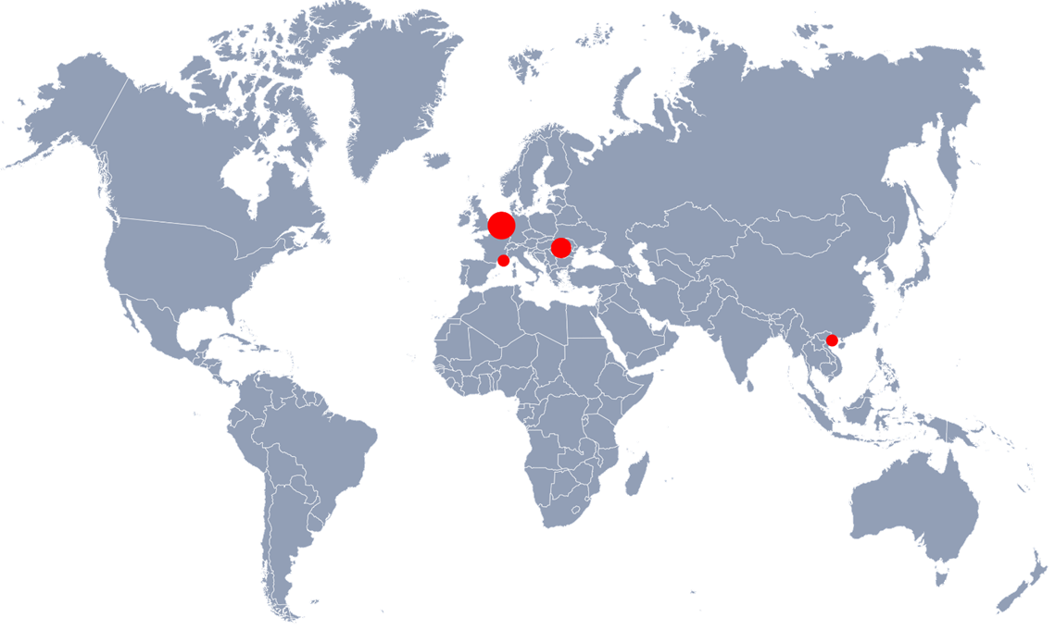
Our locations
The Netherlands
Nijmegen (HQ),
Rotterdam,
Drachten
Romania
Galati,
Mangalia
France
La Ciotat
Vietnam
Hai Phing

Slide 13
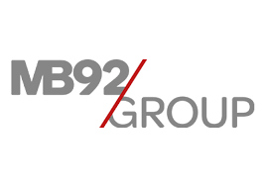
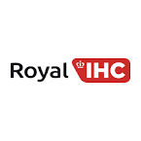
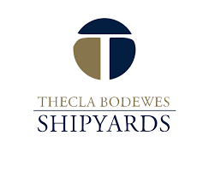
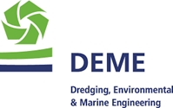
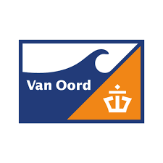
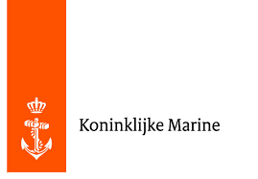
Our customers Whom we connect

Slide 14
Dredging, Offshore, Transport
OceanXplorer
Oceanographic survey vessel (85.3m)
Refit: electrical outfitting
Amazon
Pipe Laying Vessel (199m)
Refit, installation of all electric cabling for complete refit.
Liberty Island
TSHD (96m)
Refit, Dredge Control System (DCS) with intuitive HMI operating philosophy

Slide 15
Yachting
Amels 6000 series
Superyacht (120m)
Newbuild: Complete electrical, Nav-Com and AV/IT systems installation
Black Pearl
Sailing Yacht (106m)
Newbuild: System integration, complete electrical installation
SeaXplorer La Datcha
Expedition Yacht (77m)
Newbuild: AV/IT system, CCTV system

Slide 16
Naval and governmental
Zr. Ms. Den Helder
Combat Support Ship (179,5m)
Newbuild: installation activities, including military equipment
Reformador
Long Range Ocean Patrol Vessel (107,5m)
Newbuild: system integration; installing; supervising; commissioning on site
Nuyina
Antarctic Supply and Research Vessel (160m)
Newbuild, electrical engineering and integration, equipment delivery, supply and installation of loose equipment and cables.

Slide 17
Industry
Food
• T. Boer & Zn
• New main distributor for extra cold storage
Process and manufacturing
• Ardagh Metal
• New production line
Geothermal energy
VB projects
Supply and installation of the automation and electrical systems required for the expansion of a heat transfer plant

Slide 18
Why choosing Alewijnse
Customer quotes
‘’The quality is outstanding’’
“Alewijnse works with you as a co-maker and partner.”
“The company has got in depth knowledge on multiple systems in many branches.”
“We are confident in their ability to meet challenges on complex, specialist vessels.”
“The company’s design and installation engineers form a valuable part of our yard team.”
“Our projects are completed thanks to excellent all-round cooperation and the total commitment.”
“Alewijnse shows that they are flexible and can handle a service job like this using local staff and their remote access capability.“
“This project called for passion, dedication, and extraordinary craftsmanship. The strong relationships that we built with our trusted partners and suppliers is key to the success of such a complex endeavour. We are thankful for the positive energy, proactive attitude and enthusiasm that was brought to the recreation of our project by the whole Alewijnse team.”

